Slide 1


Slide 2
Project no –65 Group no _06
NAME R0LL NO
VIPUL PAL --------------- 04
SUMIT SINGH ----------- 05
HARSH PANDAY ------ 15
SUBJECT TEACHER ---- DR. DHANPRATAP SINGH

Slide 3
Car recommendation system
Home
About us
Search vehicle
Login
User account
Contact us
Admin (car portion)
Admin(user portion)

Slide 4
INTRODUCTION
1-We developed this project to book a car on rent at the fare charges.
2- In present system all booking work done manually and it takes very hard work to maintain the information of booking and cars.
3-It only makes the process more difficult and hard.

Slide 5
INTRODUCTION
4-This aim of the project is to automate the work performed in the car rental management system like generating daily bookings, records of car or cab available for booking, record of routes available, rental charges for cars for every rout, store record of the customer.
5-Based on this information you can take decision regarding your business development.

Slide 6
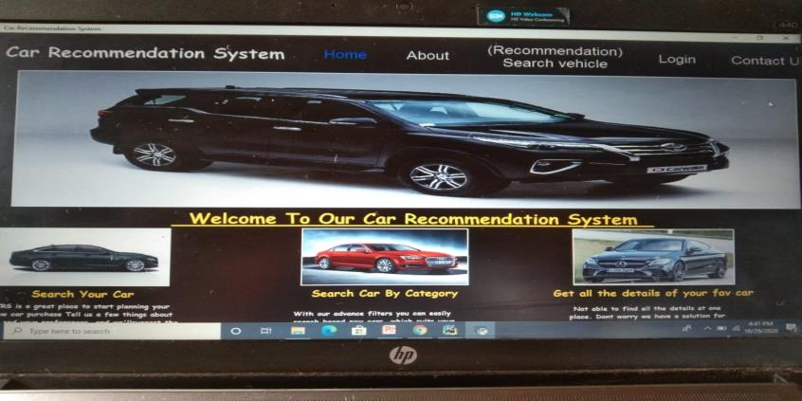
car RECOMMENDATION SYSTEM

Slide 7
What is car recommendation system
Car recommendation system find the our dream car .
Car recommendation systems are taking more importance in online businesses.
The propose a new item or product that a user will like can increase sales substantially.

Slide 8
About us
About us page give information what is this project and why we chose this project in python subject.
In website given the admin information .
About us page introduced the website admin.

Slide 9
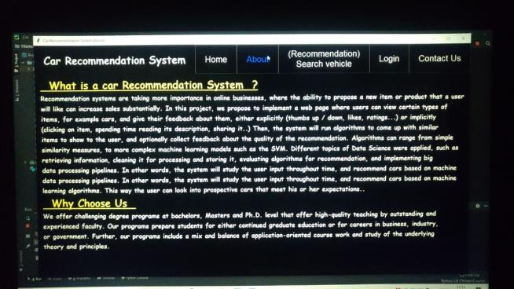
About us page

Slide 10
user login
First fill email id and password then enter in this system.
Important both email and password for enter this system.
Every network user can have their own username and password to log in to the interface

Slide 11
Administrator Login
To login into the Online Car Selling application we need two properties, Username and Password.
When connected to the background management platform that is to URL then the administrator login page will be displayed and will ask the username and password, according to the administrator views on the management page.

Slide 12
Login from GUI
The login page was designed in ASP.NET which is linked with the SQL Server Database via a .mdf file or driver manager.
To login every client needs to put the username and password that were used during registration.
So login page, Login1.aspx is connected with the SQL via driver manager.

Slide 13
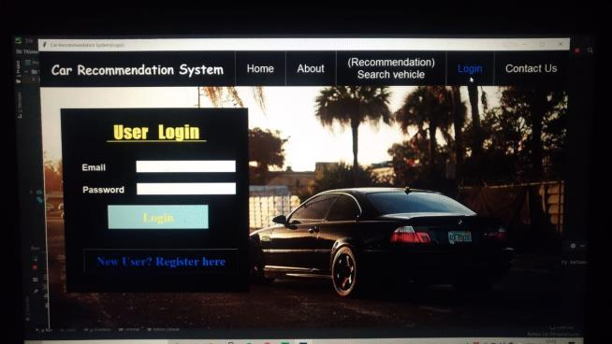
User login system

Slide 14
User account
A user account allows or does not allow a user to connect to a network, another computer, or other shares.
. Any network that has multiple users requires user accounts.
A good example of a user account is an Internet or your e-mail account.

Slide 15
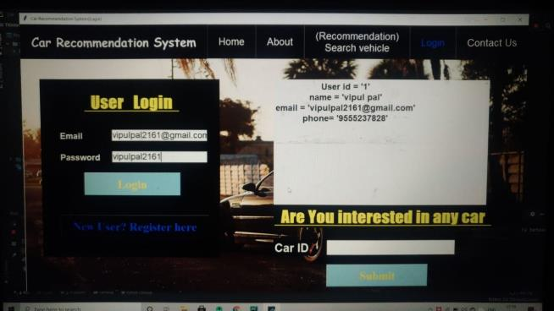
User account page

Slide 16
User registration
User Registration plugin provides you with an easy way to create frontend user registration form and login form.
The plugin is lightweight, extendible, and can be used to create any type of registration form.

Slide 17
Registration fromGUI
The registration page was designed in ASP.NET which is linked with the SQL Server Database via a .mdf file or driver manager
Every field offers the user to put personal information.
So the registration page Registration.aspx is connected with the SQL via driver manager

Slide 18
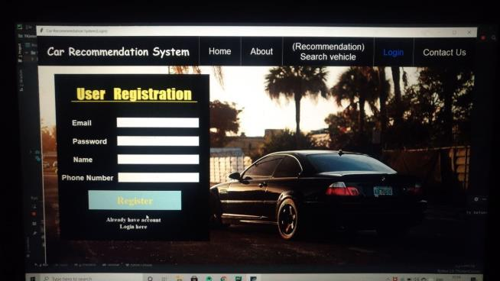
User registration

Slide 19
Search vehicle
Search box in write any car name.
car details are visible front of you.
You need the car number plate details to get the required information.
Visit the official website of VAHAN and click on 'Know Your Vehicle Details' and enter the required details to get your car registration certificate details.

Slide 20
Search vehicle by category
The project is categorized into various categories for each type of vehicle like car where sellers can post their second hand vehicle ads for sale in respective category.
Search vehicle by car id and car number and then by car details car will be seen on front of you.

Slide 21
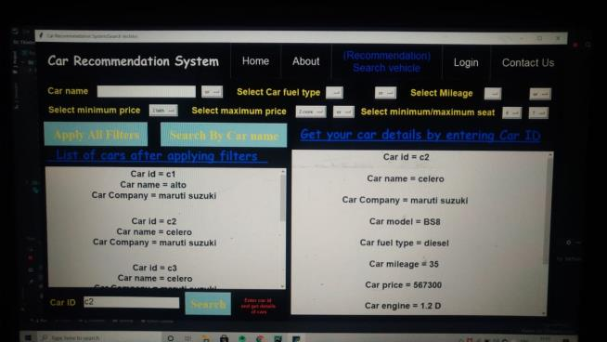
Search vehicle

Slide 22
Contact us
For contact us in three option are required email, username ,phone no ,description.
Description in describe his comments(talk).

Slide 23
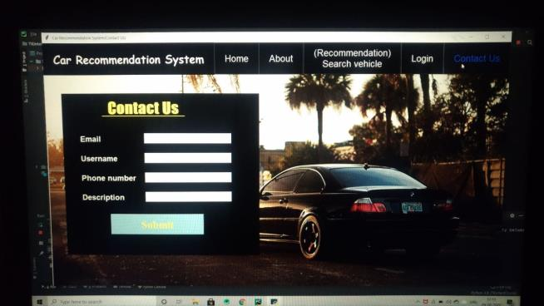
Contact us page

Slide 24
Admin(car portion)
Admin control the car details modal car id, car name, car mileage, car price car company , car engine , car transmission , car capacity and car color , also important talk about car related.

Slide 25
Car control
1-There are three properties in the Car Control section named add car, update car, delete car which are controlled by the administrator.
2-After logging the car option is clicked and then it will be possible to see the list of car information.
3-After logging the car option is clicked and then it will be possible to see the list of car information.

Slide 26
Car control
4-There are two links named edit and delete options.
5-By clicking on those links we can update the car information page.
To complete this task the user must be admin

Slide 27
Car or view car
Without registering anybody can visit the Online Car Selling Application because of accessing free. In our application there is a link button named car.
In the car catalog 18 contains car name, model, engine size, price, warranty, country, mileage, number of cars, product id and preview. From this page customer can choose their preference.

Slide 28
Car details
By clicking the Car option in the Online Car Selling Application everybody will be able to see all information about the car.
The Car.aspx page is connected with the SQL database; as a result all information is stored in my project database.
From the car page we can select a product by selecting a car model.

Slide 29
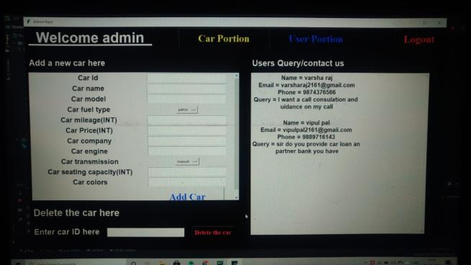
Admin (car portion)

Slide 30
Admin(user portion)
Admin (user option) handle the Handles many other users.
When connected to the background management platform that is to URL then the administrator login page will be displayed and will ask the username and password, according to the administrator views on the management page.

Slide 31
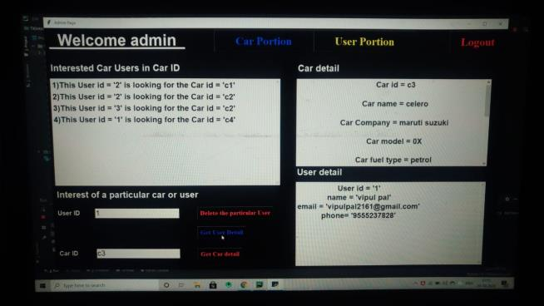
Admin (user portion)

Slide 32
Admin control
There are two properties in the admin control named Username and Password.
Username = admin2161
Password = puma100crore
When the management option is clicked then you will be possible to see the admin interface.
In the admin control section the administrator plays an important role in the Online Car Selling Application for example by adding a car, deleting a customer, deleting a car and updating information.

Slide 33


